Slide 1

Unit-5 Application Building with IoT
IOT and Applications
GTU # 3160716
Prof. Kalpesh H Surati
Computer Engineering Department
Kalpesh.surati@darshan.ac.in
+91 99250 10033

Slide 2
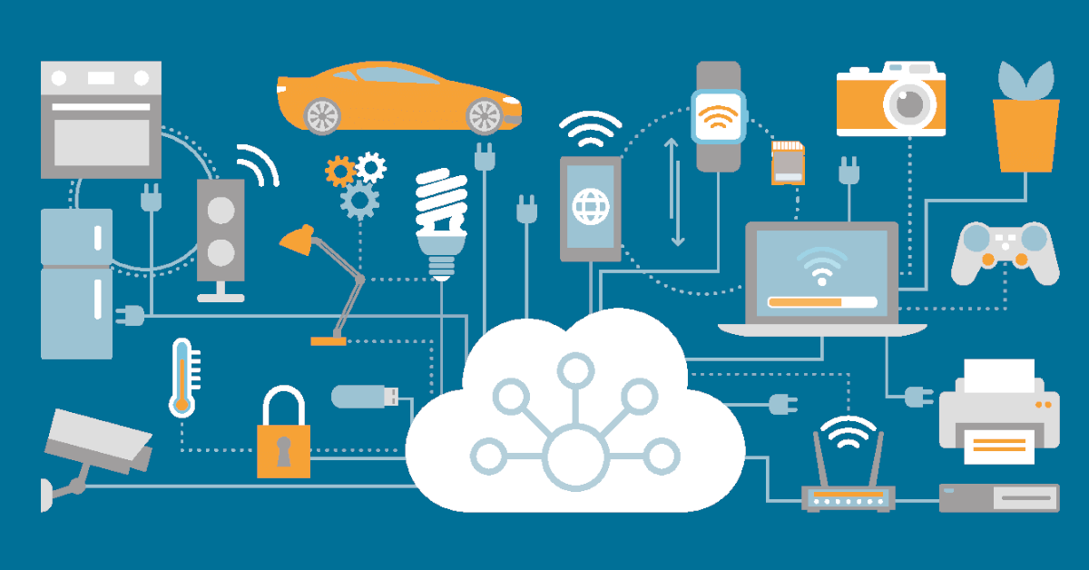
Applications with IoT
Overview
Using IoT we can build many applications but here, few IoT Applications will be discussed.
We will cover following topics of the IoT applications.
Overview – General Practice
Importance – Why we need?
Requirements – Materials and Facility
Architecture – Functional Block Diagram
How it works – General Working of IoT Applications
Before we explore them one by one, let’s understand the common architecture of the IoT applications.

Slide 3
Applications with IoT
Common Architecture for IoT Application
This “Local Analysis, Processing and Controlling” section may not be there in many IoT solutions
All Kind of Sensors,
GPS, etc.
In House Monitoring or Care Taker Team Members
Local Monitoring
Remote Monitoring or Care Taker or Emergency Help Team Members.
Sensor Nodes
Remote Monitoring
Link
Controller Node
Fog / Local Computer
Cloud Services
Internet
Internet Gateway
Link
Internet
Link
Actuator Nodes
Central and Remote
Storage/Analysis
Data Analytics
Within Organization for
Local Analysis, Processing and Controlling
Relays, Alarms, Motors, Actuators, Light Indicators, etc.
Research / Decision Making
Where, Link: Wire, LAN, Wi-Fi, or Bluetooth Connectivity

Slide 4
Applications with IoT
Common Architecture for IoT Application
This Local Analysis, Processing and Controlling section may not be there in many IoT solution
Relays, Alarms, Motors, Actuators, Light Indicators, etc.
In House Monitoring or Care Taker Team Members
Local Monitoring
Remote Monitoring or Care Taker or Emergency Help Team Members.
Actuator Nodes
Remote Monitoring
Link
Controller Node
Fog / Local Computer
Cloud Services
Internet
Internet Gateway
Link
Internet
Link
Sensor Nodes
Central and Remote
Storage/Analysis
Data Analytics
Within Organization for
Local Analysis, Processing and Controlling
All Kind of Sensors, GPS, etc.
Research / Decision Making
Where, Link: Wire, LAN, Wi-Fi, or Bluetooth Connectivity

Slide 5
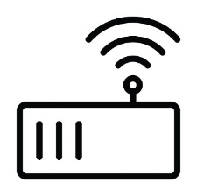
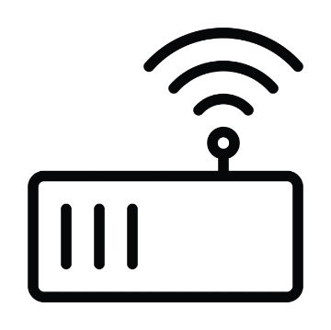
Applications with IoT
How it works
All the sensor and actuator nodes should be placed at appropriate place.
The sensor and actuator nodes should have proper connectivity with controller nodes or direct to the cloud server.
The sensor nodes sends the sensed data to the controller nodes or directly to the cloud server.
The controller node
Collects the data from all the sensors,
Apply some business logic on it as per the requirements and
Send it to the Fog or local computer, or directly to the cloud server.
Sensor Node
Actuator Node
Gateway
Actuator Node
Sensor Node
Sensor Node

Slide 6
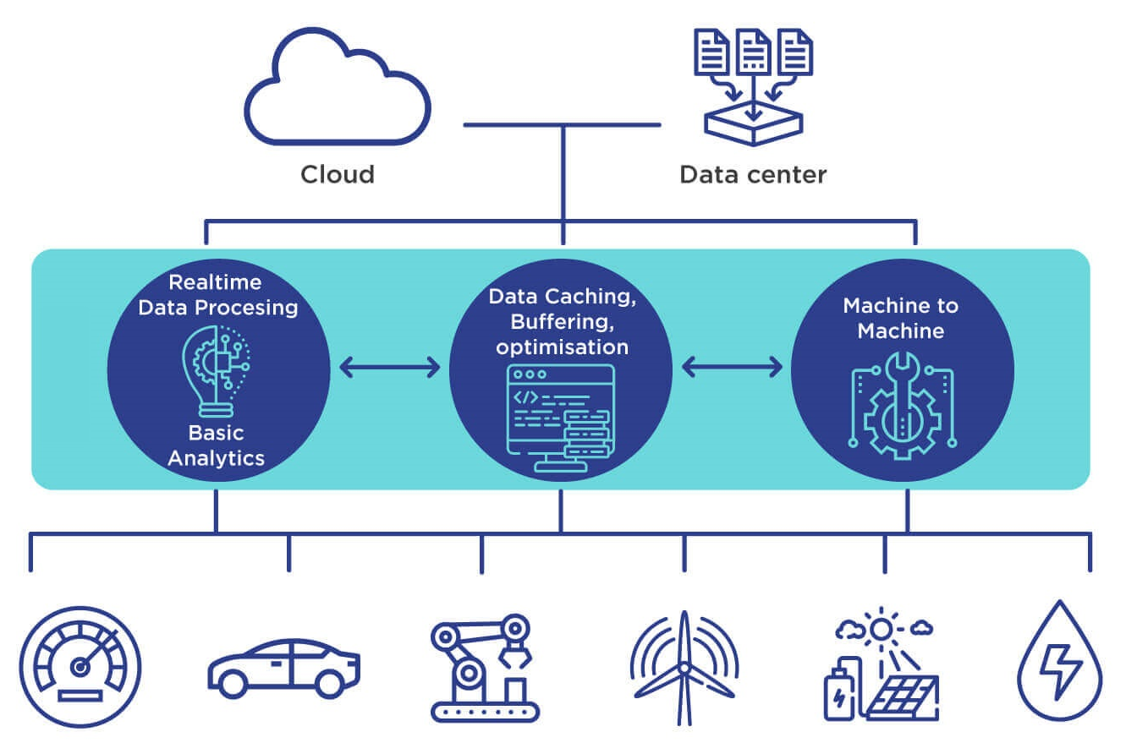
Applications with IoT
How it works
All the controller nodes should have connected with the Fog or local computer network, or directly to the cloud server via Internet.
Fog or local computer
Receives all the data from all the controller nodes,
Execute some business logic and
Do analysis on the collected data, and
Send the filtered limited data to the cloud computer as well as
Send the alert messages to the local team.
The Fog computer should have Internet connectivity for the cloud communication.

Slide 7
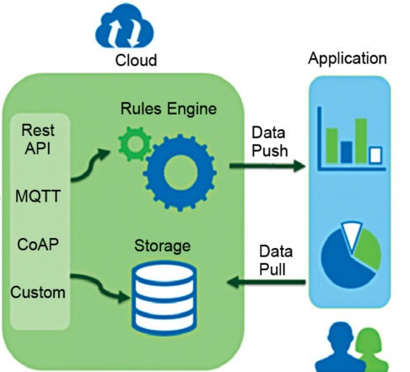
Applications with IoT
How it works
All the in House Monitoring team members can access status of all the sensors from the Fog/Local computer.
The cloud
Stores all the data received from the Fog/Local computer or directly from the sensors,
Execute some business logic and
Do analysis on the stored data.
All those who have rights to access the cloud data can get desire information from it, like
Remote monitoring team members,
Data analytics team

Slide 8
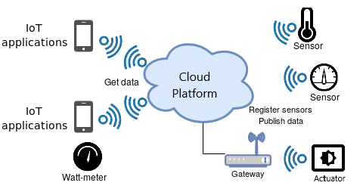
Applications with IoT
How it works
The care taker and data analytics teams may execute corrective action based on the analyzed data.
They may
Send command to the local computer or to the actuators directly and
Broadcast alert messages to the concern persons.
All the actuator nodes receives command from the cloud directly or from the controller or local computer.
The “Local Analysis, Processing and Controlling” section may not be there in many IoT solution.

Slide 9
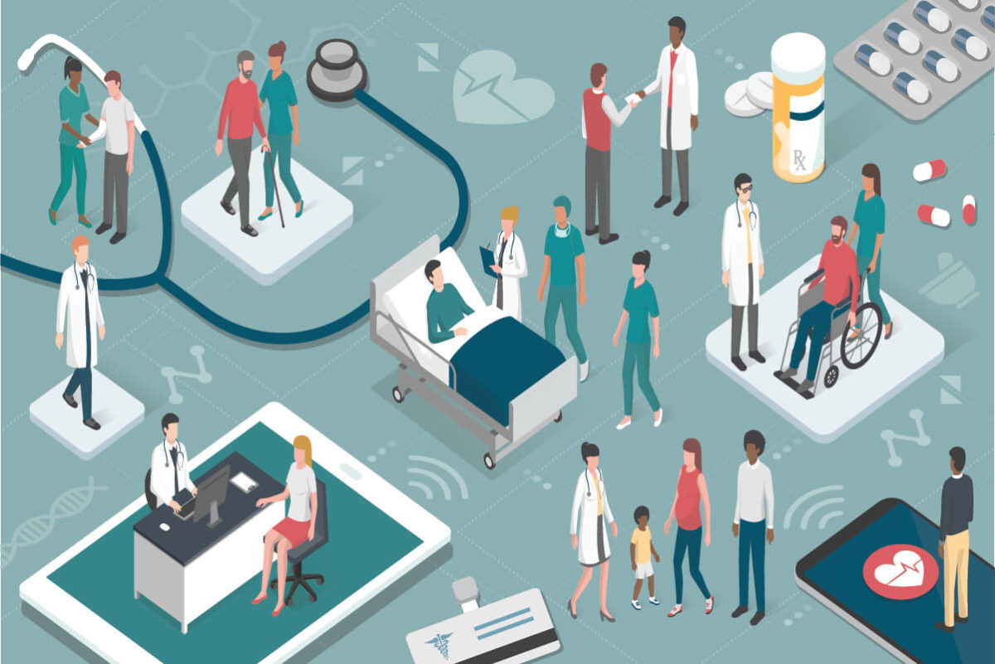
Healthcare Application with IoT
Overview
The healthcare sector consists of medical and related goods and services.
Healthcare sector provides medical services for maintaining or improving health via
Prevention
Diagnosis
Treatment
Recovery or cure of disease, illness, injury, and other physical and mental harms in people.
Healthcare sector is much diversified and is full of opportunities in every segment.

Slide 10

Healthcare Application with IoT
Overview
Healthcare is delivered by health professionals.
Medicine
Dentistry
Pharmacy
Nursing
Psychology
And other health professions are all part of health care.
Healthcare has become one of India’s largest sector in terms of revenue and employment.

Slide 11
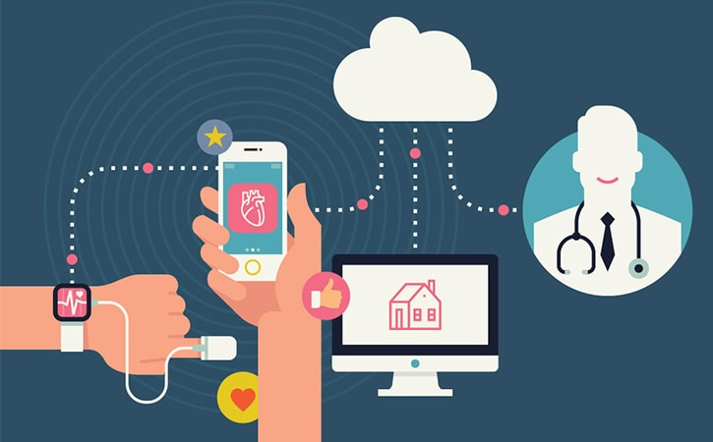
Healthcare Application with IoT
Importance
Before Internet of Things, patients’ interactions with doctors were limited to visits.
There was no way doctors or hospitals could monitor patients’ health continuously.
IoT enabled devices have made remote monitoring in the healthcare sector possible.
IoT helps
To keep patients safe and healthy,
Empowering physicians to deliver superlative care.

Slide 12
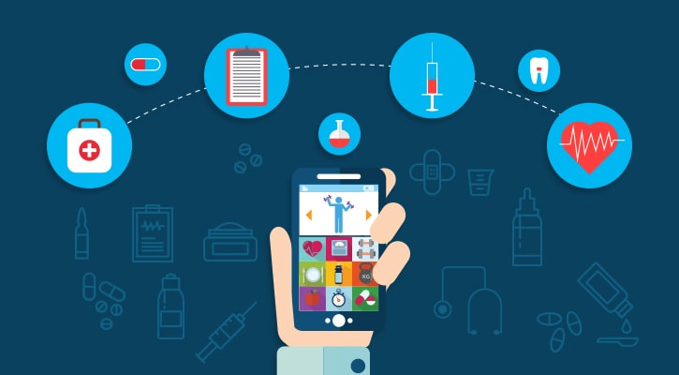
Healthcare Application with IoT
Importance
Remote monitoring of patient’s health helps in
Reducing the length of hospital stay and
Prevents re-admissions.
IoT has applications in healthcare that benefit to
Patients
Families
Physicians
Hospitals and
Insurance companies.

Slide 13
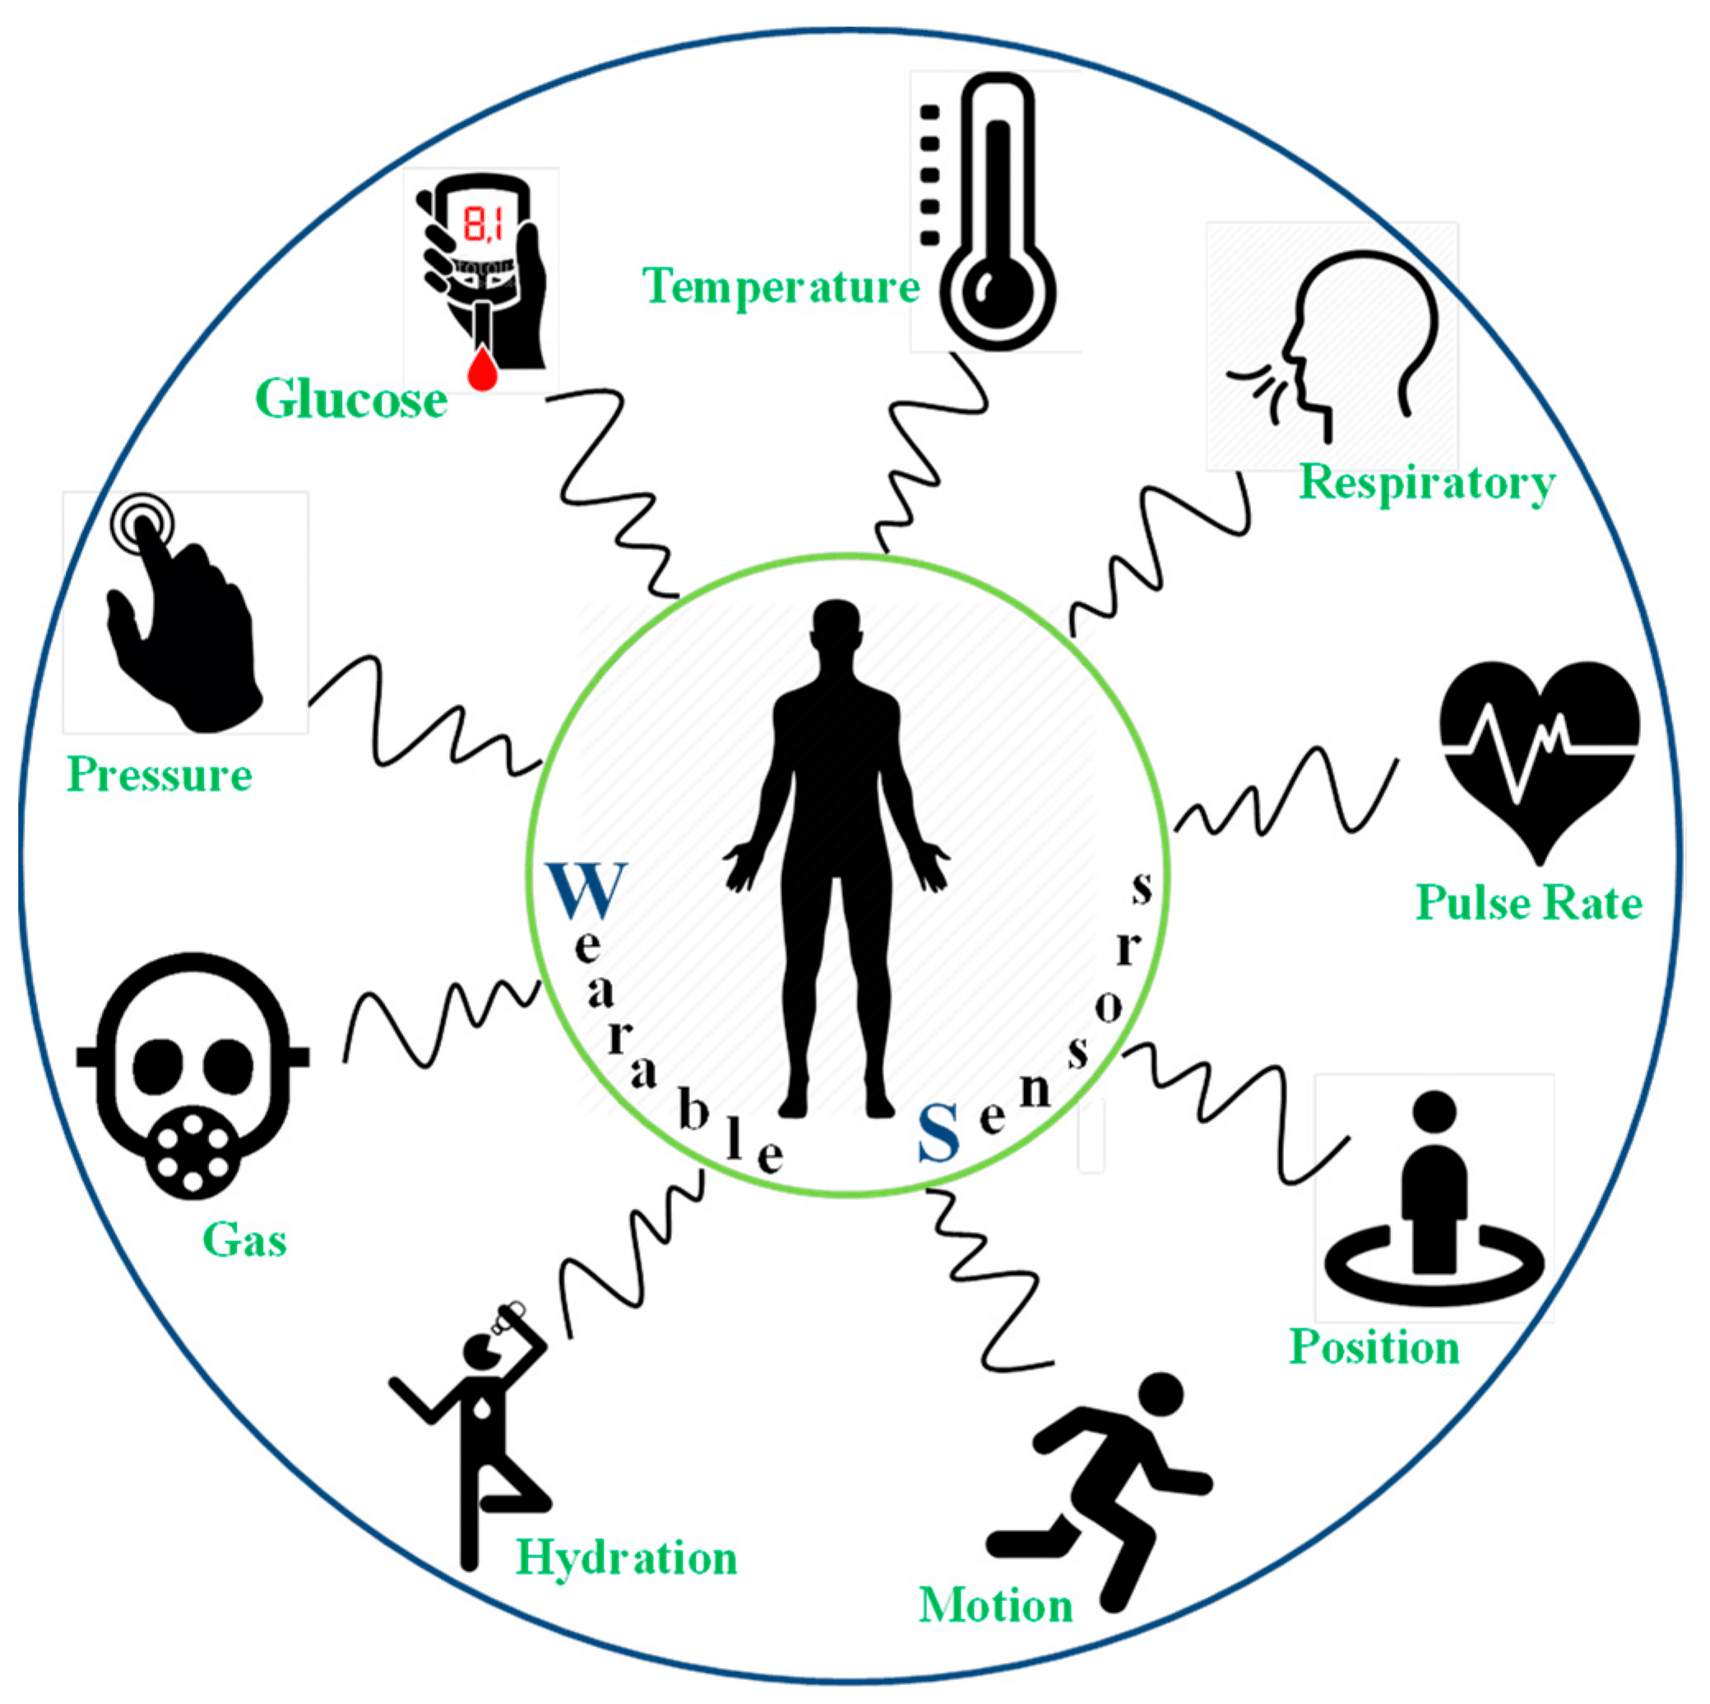
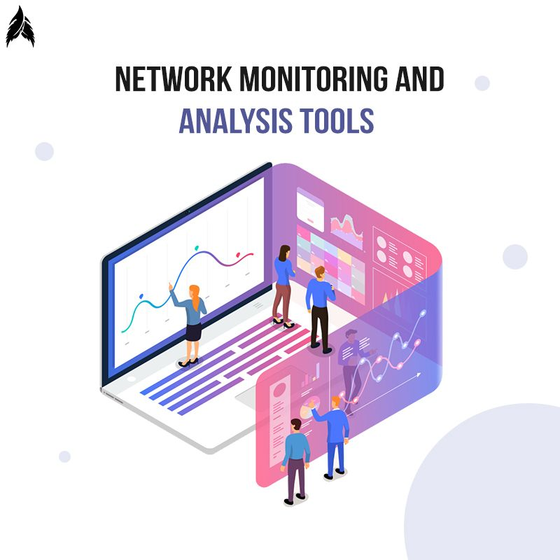
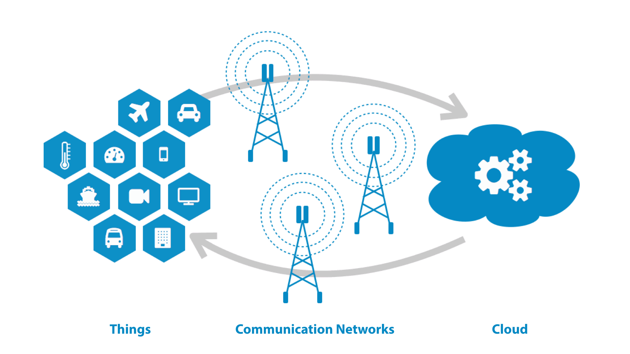
Healthcare Application with IoT
Requirements for IoT Setup
Sensors
Heartbeat Sensor
Oxygen Level Sensor
Glucose Level Sensor
Controller
ESP8266 Node MCU or
Arduino Uno with Wi-Fi or Network Shield
For Monitoring and Analysis
PC
Mobile
Tablet
For Fog Computing
Raspberry Pi or
PC
LAN and WAN Connectivity
Router and Switches
Wireless Access Point
Cloud Services

Slide 14
Healthcare Application with IoT
Architecture
Nursing Staff and Doctors
Nursing Staff and Doctors
Heartbeat Sensor Node
Local Care Taker Monitoring
Remote Care Taker Monitoring
Internet
Wi-Fi
Patient Wise Node
Wi-Fi / LAN
Oxygen Sensor Node
Wi-Fi
Controller Node
Wi-Fi LAN
Fog Computer
Cloud Services
Internet
Data Analytics
Internet Gateway
Within Organization for Local Analysis and Processing
Research / Decision Making
Central and Remote
Storage/Analysis
Internet
Wi-Fi
Glucose Sensor Node
Patients Family

Slide 15
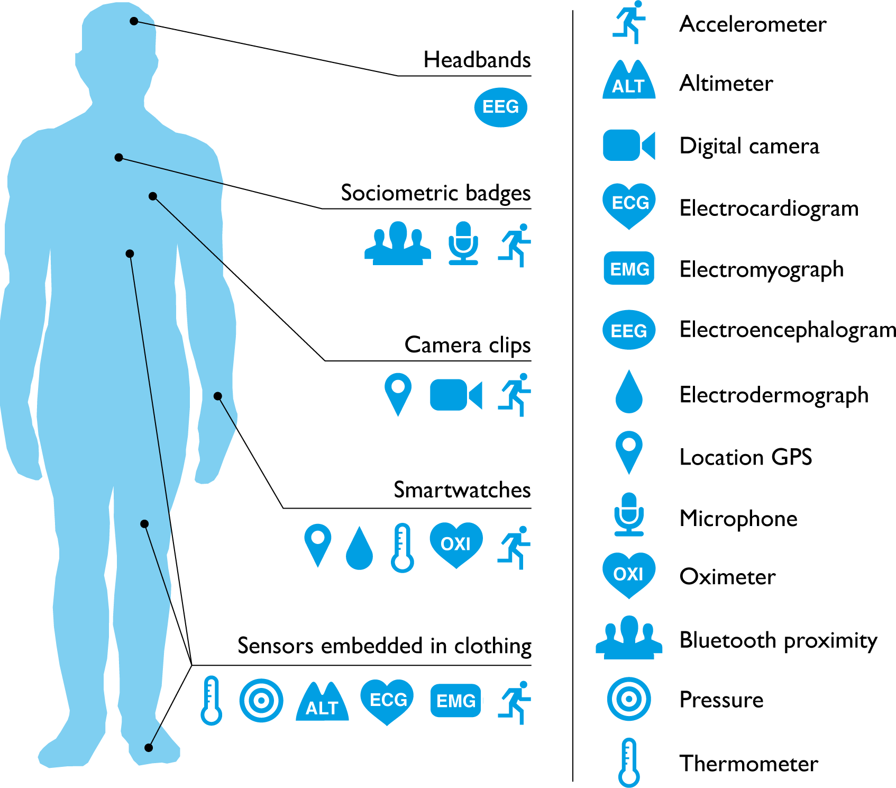
Healthcare Application with IoT
How it works
All the sensor nodes should be placed on patient body, either direct or using wearables.
The sensor nodes should have Wi-Fi connectivity with a controller node of the patient.
The sensor nodes sends the sensed data to the controller node.
The controller node collects
The data from all the sensors,
Apply some business logic on it as per the requirements and
Send it to Fog computer.
All the controller nodes of all the patients should have connected with the Fog computer network.

Slide 16
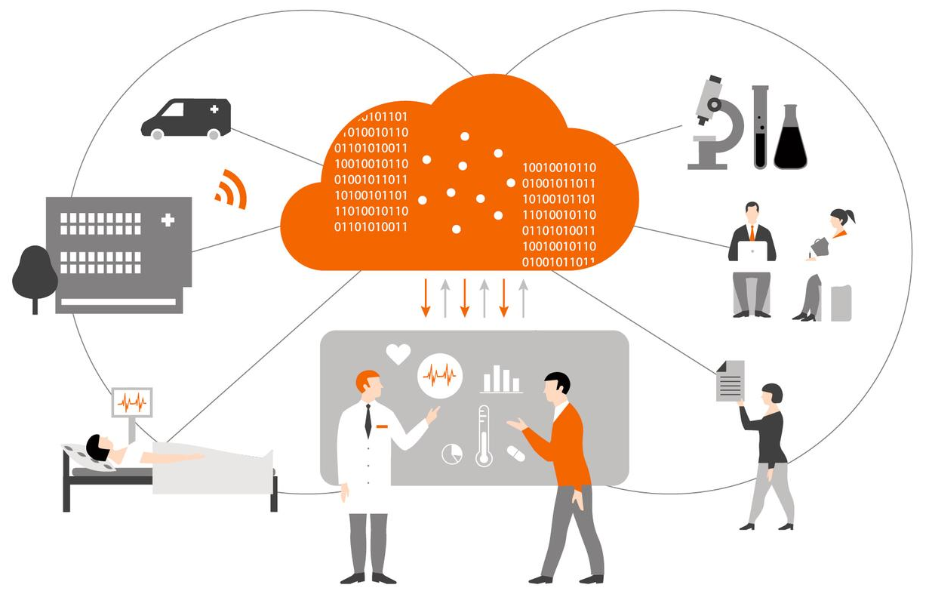
Healthcare Application with IoT
How it works
Fog computer
Receives all the data from all the controller nodes
Execute some business logic and
Do analysis on the collected data, and
Send the filtered limited data to the cloud computer as well as
Send the alert messages to the care taker team (nursing staff and doctors).
The Fog computer should have Internet connectivity for the cloud communication.
All the local care taker team members can be accessed health status of all the patients from the Fog computer.

Slide 17
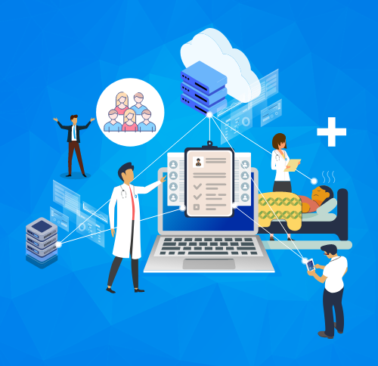
Healthcare Application with IoT
How it works
The cloud
Stores all the data received from the Fog
Execute some business logic
Do analysis on the stored data
All those who have rights to access the cloud data can get health records of the patients, like
Remote care taker team members
Data analytics team
Patient family members
The care taker and data analytics teams may execute corrective action based on the data and alert messages.

Slide 18
Healthcare Application with IoT
Summery
IoT has changed people’s lives by enabling constant tracking of health conditions.
Wearables connected devices like blood pressure and heart rate monitoring cuffs, glucometer etc. give patients attention.
On any changes in the routine activities of a person, alert message sends to family members and health service providers.
IoT enables healthcare professionals to be more watchful.
Data collected from IoT devices can help physicians identify the best treatment process.
IoT devices tagged with sensors are used for tracking real time location of medical equipment like wheelchairs, nebulizers, oxygen pumps and other monitoring equipment.
IoT-enabled hygiene monitoring devices help in preventing patients from getting infected.
It also help in asset management like pharmacy inventory control, and environmental monitoring, for instance, checking refrigerator temperature.

Slide 19
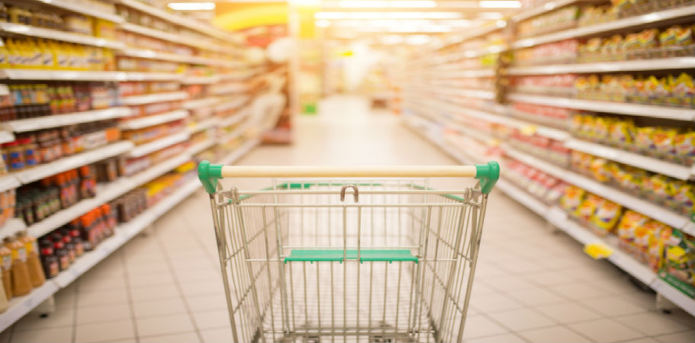
IoT Application in Retail
Overview
Retail is the process of selling consumer goods or services to end-users for earning a profit.
The retail sectors can be divided into
Food,
Clothing & Textiles,
Consumer Durables,
Footwear,
Jewelry,
Books-Music-Gift Articles, etc.

Slide 20
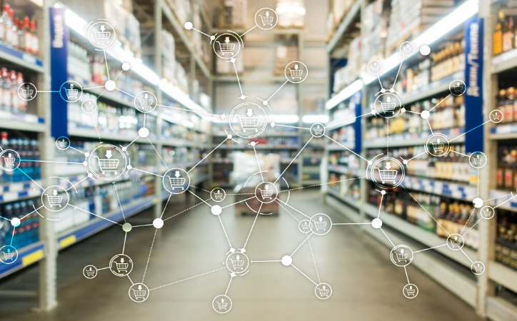
IoT Application in Retail
Importance
In the retail industry customer plays key roll
The retail industry is rapidly transforming with IoT solutions.
IoT is taking the center stage in the sector.
Inventory management has been an expensive and tedious process.
IoT system automatically monitors inventory.
Send alert messages to managers if a certain item is running low or going to expire soon.
IoT devices are also helpful for avoiding
Oversupply
Shortage of goods and
Thefts in stores.

Slide 21
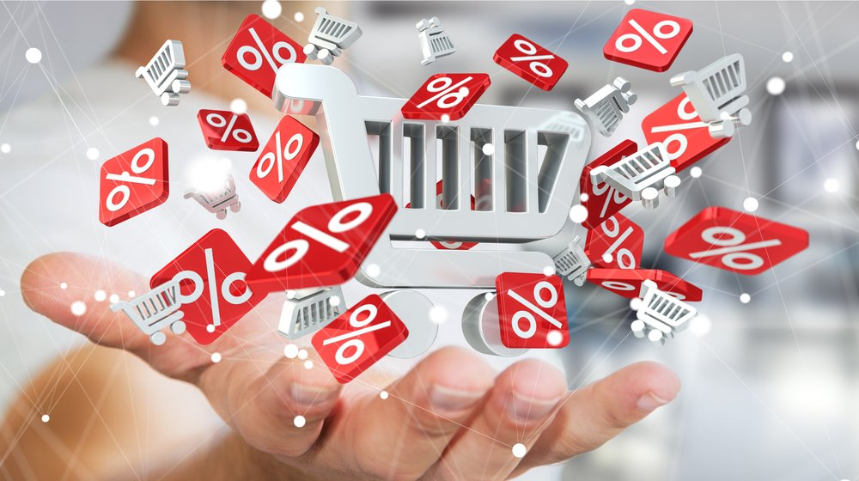
IoT Application in Retail
Importance
Customers are notified about discounts and offers in real-time.
It give data about customer behavior and routes.
IoT helps to increase
Customer loyalty,
Boost sales,
Offer a personalized experience, and
Improve inventory management.

Slide 22
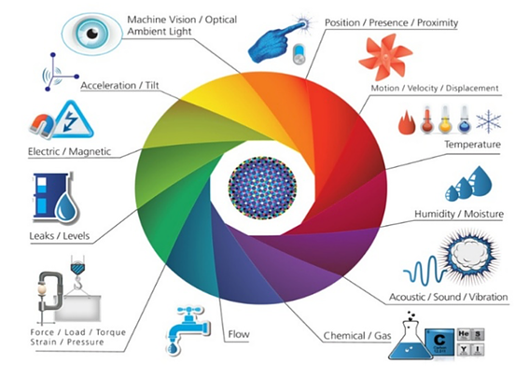
IoT Application in Retail
Requirements for IoT Setup
Sensors
Actuators and Tags
For Monitoring and Analysis
PC
Mobile
Tablet
Touch Sensors
Gas Sensors
Fire Sensors
IR Sensors
Alarm
Water Sprinkler
Beacons
RFID Tag and RFID Reader
Controller
ESP32 MCU or
Arduino Uno with Wi-Fi or Network Shield
LAN and WAN Connectivity
Router and Switches
Wireless Access Point
Cloud Services

Slide 23
IoT Application in Retail
Architecture
For Inventory Management
For Feedback
On Each Item
On Smart Shelves
Store Manager and Other Staff
Touch Sensor Nodes
RFID Tags
RFID Readers
Wi-Fi
Monitoring System
RIFD Tag Data
Wi-Fi / LAN
Central
Storage/Analysis
For
Safety
Gas & Fire Sensor Nodes
Internet
Controller Nodes
Wi-Fi LAN
Local Server
Cloud Services
Internet
Data Analytics
Internet Gateway
Wi-Fi
Light & Temp. Sensor Nodes
Internet
For
Ambiance
Wi-Fi / LAN
Beacon Data
Within Organization for Local Analysis and Processing
Research / Decision Making
Beacons
Customers
Camera & IR
Sensor Nodes
Alarm & Water Sprinkler Node
Bluetooth
Wi-Fi
For Safety
For In-store Navigation &
Real Time Offers
For In-Store,
Entry-Exit & Parking

Slide 24
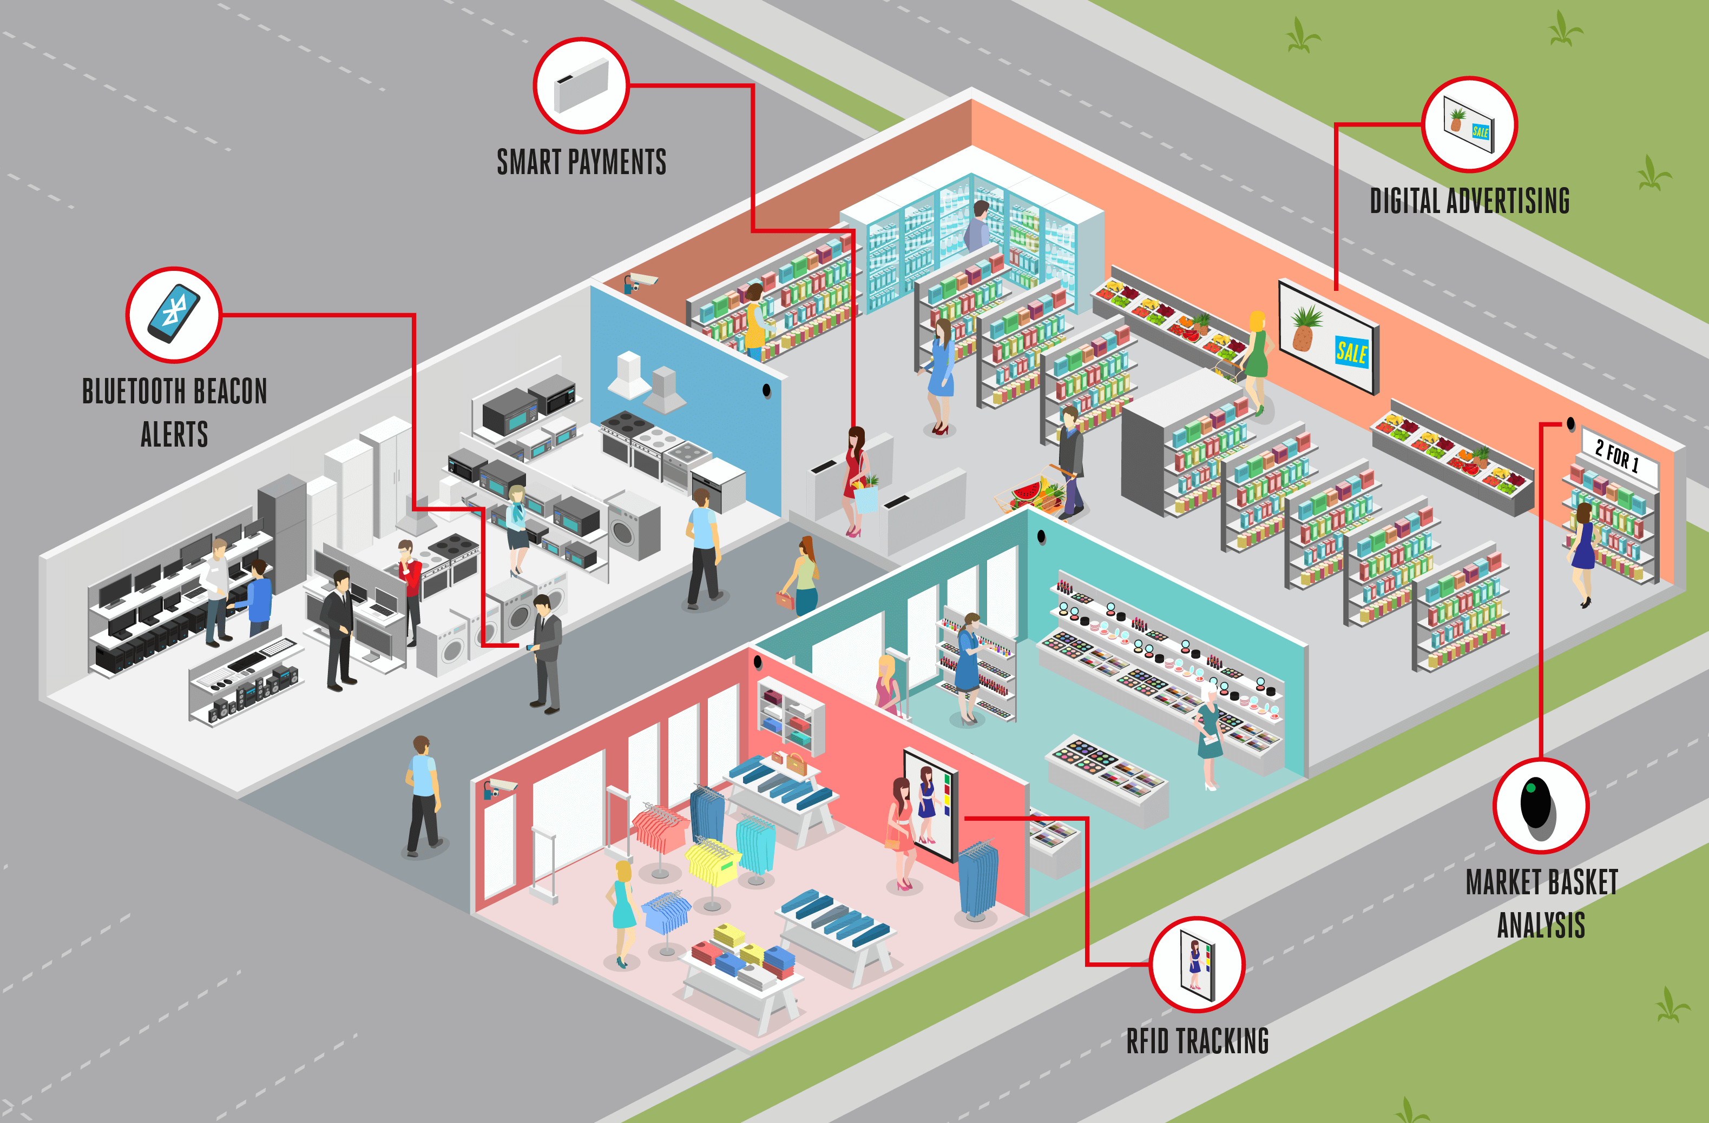
IoT Application in Retail
How it works
All the sensor nodes and Beacons should be placed at various places in the store, washroom and parking area.
The sensor nodes should have Wi-Fi connectivity with controller nodes.
The sensor nodes sends the sensed data to the controller nodes.
The controller nodes
Collects the data from all the sensors,
Apply some business logic on it as per the requirements and
Send it to local computer.

Slide 25
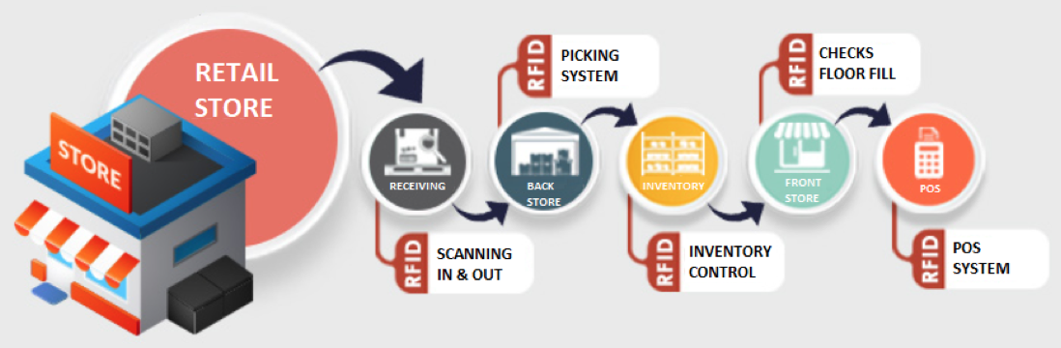
IoT Application in Retail
How it works
RFID readers should be placed at items display shelves to detect item presence in the shelves for the stock management.
All the controller nodes and RFID readers should have connected with the Local Area Network.
RFID tags should be attached with each and every item which are likely to be monitored.
Using the RFID tags one can monitor location and stock of the item.
RFID tags is also useful for auto billing and queue less exit.

Slide 26
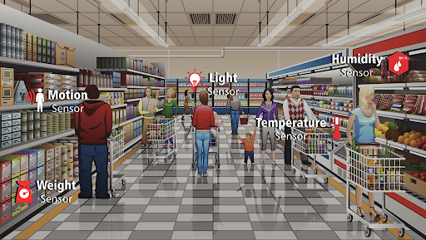
IoT Application in Retail
How it works
Touch sensors are used for customers’ feedback about ambiance and cleanness at various places like washroom, trial room etc.
Light and Temperature sensors are used for ambiance monitoring which leads to energy saving and customer comfort.
Camera and IR sensors are placed for monitoring people density at various places, person in-out ratio for store and the parking area.
Gas sensors are used for monitoring various gases levels in the store.
Fire sensor are used for detecting fire in the store and send the alert signal to the Alarm & Water Sprinkler Node

Slide 27
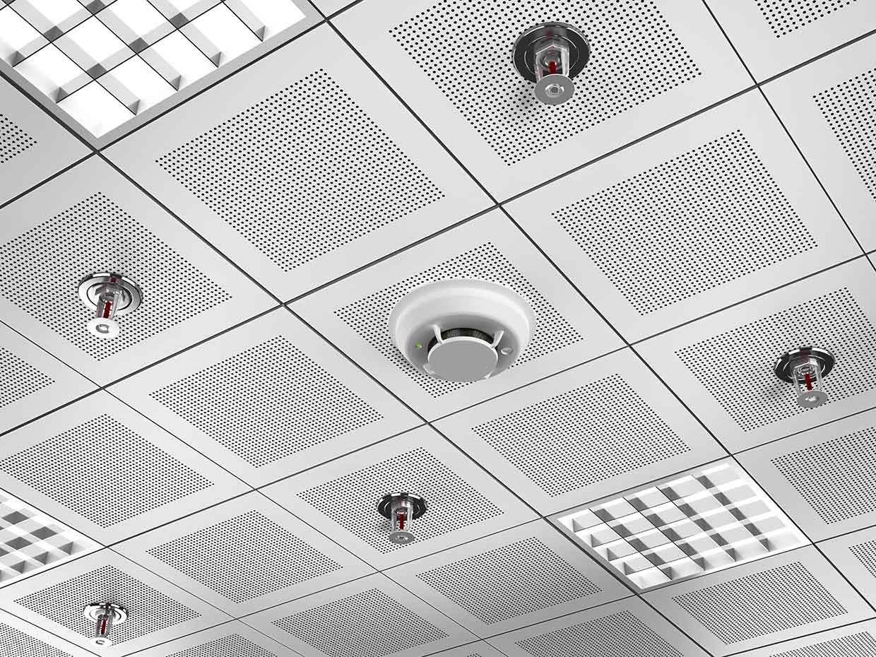
IoT Application in Retail
How it works
An alarm system and the water sprinkling system are used for fire safety, should have connected with a controller node
Local Server
Receives all the data from all the controller nodes,
Execute some business logic and
Do analysis on the collected data, and
Send the essential data to the cloud computer.
The server computer should have Internet connectivity for the cloud communication.
The cloud
Stores all the data received from the local server,
Execute some business logic and
Do analysis on the stored data.

Slide 28
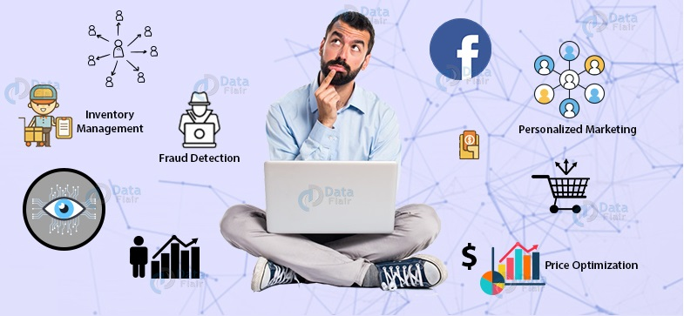
IoT Application in Retail
How it works
All those who have rights to access the cloud data can get desire information and alerts, like
Store manager
Staff members
Data analytics team
customers
The store manager and data analytics teams may execute corrective action based on the data.

Slide 29
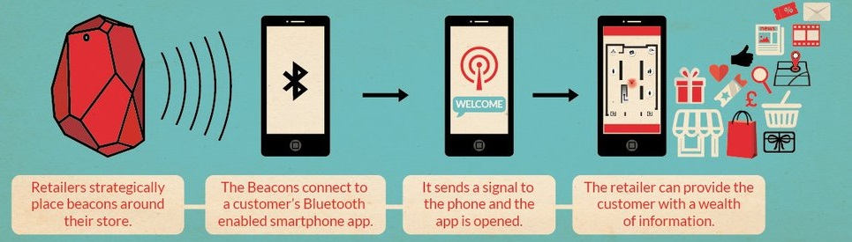
IoT Application in Retail
How it works
Beacons, a Bluetooth Low Energy (BLE) device
Automatically connect with customers’ smartphones when they entered in the coverage area.
Send push notifications directly to the customers.
Beacons can be installed at various places
For customer in-store navigation,
To know foot fall in particular area of the store, and
Collecting data about customer behavior and routes.
Customers are notified about discounts and offers in real-time using the beacons system.

Slide 30
IoT Application in Retail
Summery
IoT will dramatically transform and innovate the retail industry in the coming years.
The integration of IoT solutions will enable retail companies,
To create successful marketing campaigns based on customer behavior,
Deliver high-quality services,
Improve inventory management, and
Reduce operational costs.

Slide 31
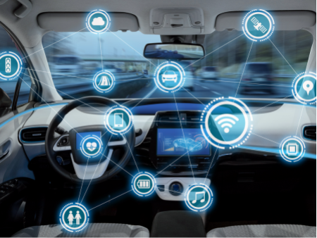
Driver Assistance Application with IoT
Overview
Vehicle manufacturing companies are trying to make vehicles more comfortable and safe for their passengers.
They are experimenting to design a system that could monitor and alert the user suffering from highway hypnosis or white line fever.
As well as they need an IoT based system to prevent accidents caused by drowsy driver.

Slide 32
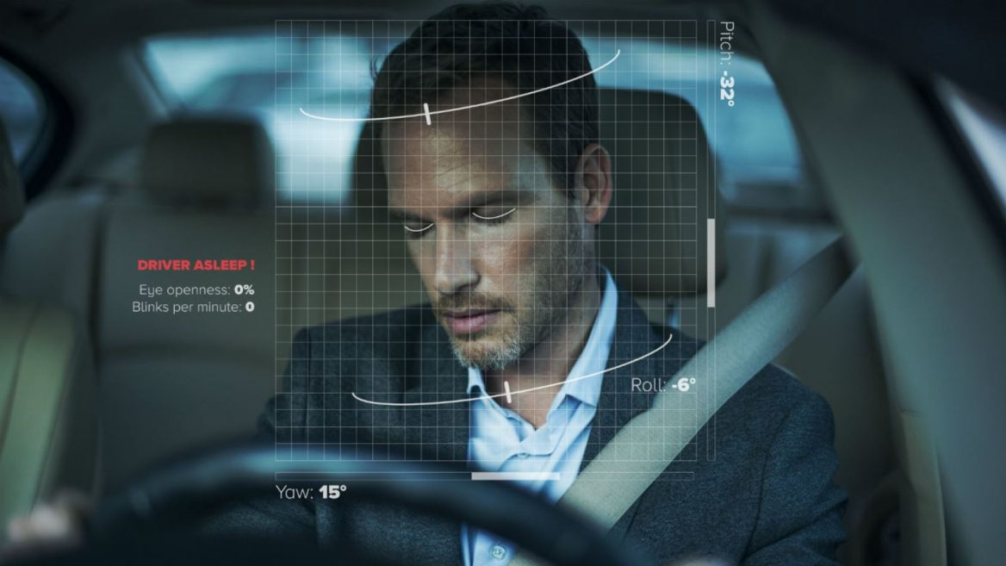
Driver Assistance Application with IoT
Importance
Driver’s drowsiness is one of the major factor is reported in road accidents.
Drowsiness is a kind of sleeping sensation which can lead for closing eyes.
Drowsiness make one physically inactive and insensitive to surroundings.
So we need to monitor driver’s consciousness along with his acceleration pattern and steering angle.
If any deviation is detected, a system should be there to alert the driver.
A process of detecting the deviation and drowsiness of the driver should be developed.

Slide 33
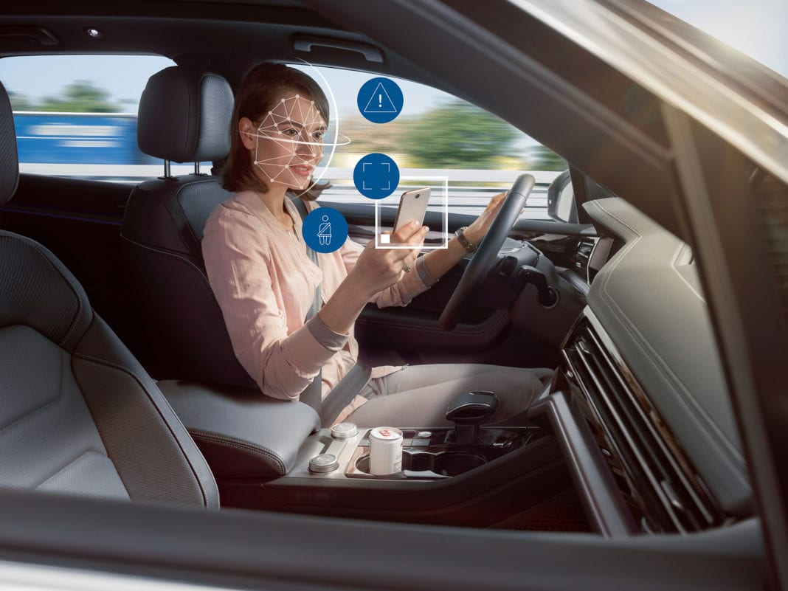
Driver Assistance Application with IoT
Importance
Using Image Processing and Machine Learning (ML) technology a system can be developed.
The system detect whether the driver has deviated or not, by monitoring the driver’s
facial movements,
Eye Aspects Ration (EAR) for drowsiness,
acceleration pattern and
change in the steering angle

Slide 34
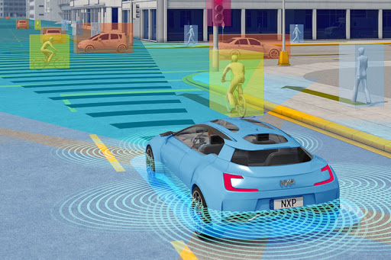
Driver Assistance Application with IoT
Requirements for IoT Setup
Sensors
Ultrasonic Sensor
Cameras
On Board Diagnostic (OBD) Access
Controlling
Raspberry Pi
For Monitoring and Analysis
PC
Mobile
Tablet
WAN Connectivity
Cloud Services

Slide 35
Driver Assistance Application with IoT
Architecture
Drowsiness Detection System
EAR Value
Driver
Alert System
Internet
Camera Units
Camera
Facial Area
USB
Lane Detection
Wi-Fi / Bluetooth
Central and Remote
Storage/Analysis
Vehicle Computer
Cloud Services
Internet
Data Analytics
Internet Gateway
Speed
Variation
Within Vehicle for Local Analysis and Processing
Wired / Bluetooth
Research / Decision Making
Internet
OBD
On Board Diagnostics Unit
Ultrasonic Sensor Nodes
Vehicle Owner
Bluetooth
Steering Angle
Distance
Surrounding Vehicle
Deviation Detection System

Slide 36
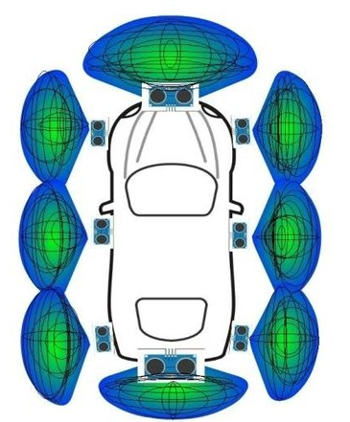
Driver Assistance Application with IoT
How it works
Camera units should be placed on board for capture the face of driver and road view.
The camera units should have USB connectivity with vehicle computer.
The camera units sends the sensed data to the vehicle computer.
The ultrasonic sensor nodes should be placed at various place on outside the vehicle for detecting surrounding distance.
All the sensor nodes should have Wired / Bluetooth connectivity with the vehicle computer.

Slide 37
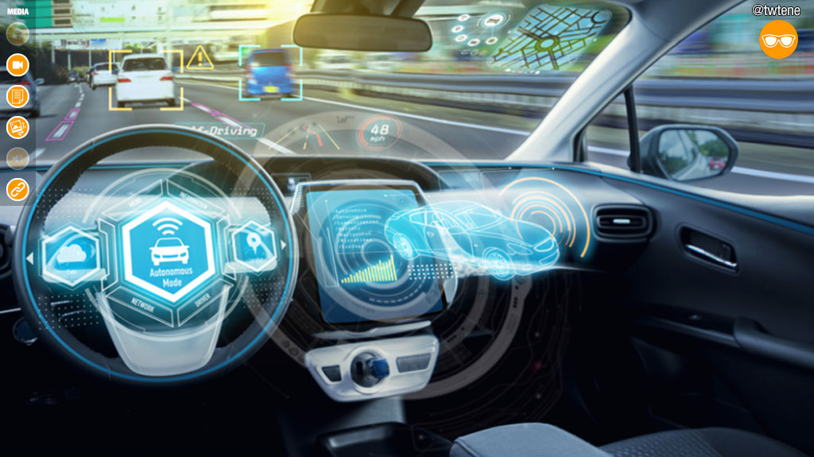
Driver Assistance Application with IoT
How it works
The OBD unit of the vehicle should have Bluetooth connectivity with the vehicle computer
The vehicle computer
Collects the data from the camera units, OBD unit and the sensor nodes, and
Apply some business logic,
Do analysis on the collected data on it as per the requirements and
Send the filtered limited data to the cloud computer as well as
Send the alert messages to the driver.
The vehicle computer should have Internet connectivity for the cloud communication.

Slide 38
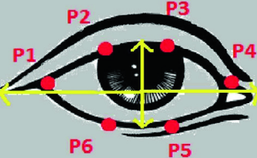
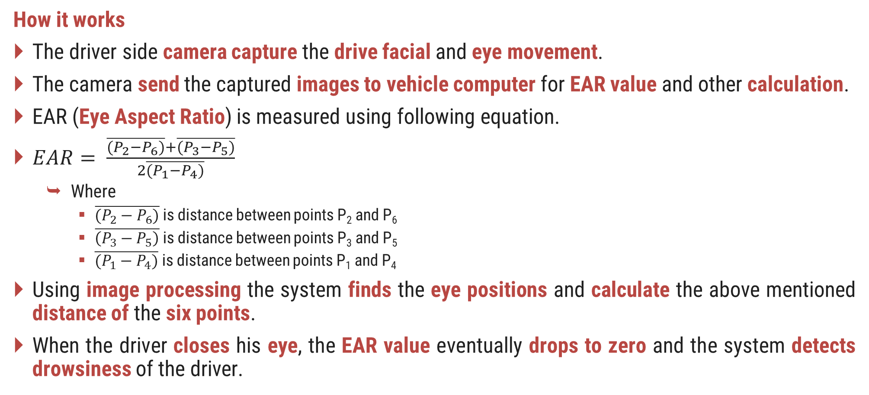
Driver Assistance Application with IoT
How it works
The driver side camera capture the drive facial and eye movement.
The camera send the captured images to vehicle computer for EAR value and other calculation.
EAR (Eye Aspect Ratio) is measured using following equation.
$EAR= \frac{\overline{(P_{2}−P_{6})}+\overline{(P_{3}−P_{5})}}{2\overline{(P_{1}−P_{4})}}$
Where
$\overline{(P_{2}−P_{6})}$ is distance between points P₂ and P₆
$\overline{\left(P_{3}−P_{5}\right)}$ is distance between points P₃ and P₅
$\overline{(P_{1}−P_{4})}$ is distance between points P₁ and P₄
Using image processing the system finds the eye positions and calculate the above mentioned distance of the six points.
When the driver closes his eye, the EAR value eventually drops to zero and the system detects drowsiness of the driver.

Slide 39
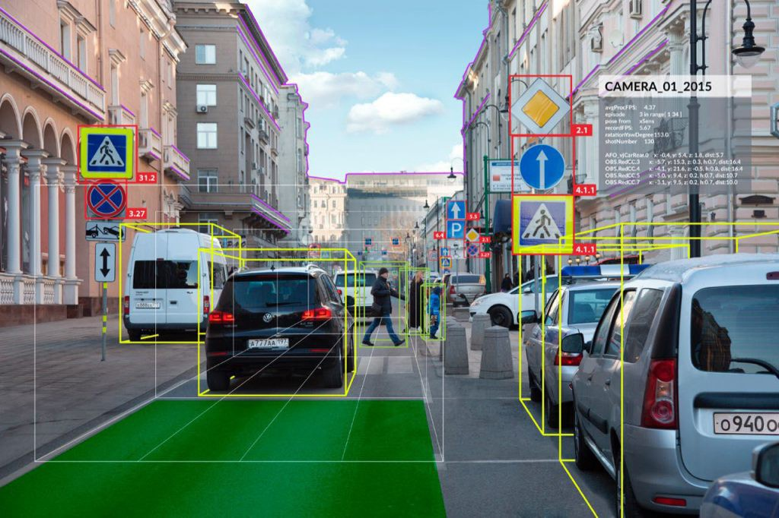
Driver Assistance Application with IoT
How it works
The road side camera capture the front view images.
The capture images sends to the vehicle computer for
Detecting lane
Objects
Sign boards
Deviation is monitored using OBD (On-Board Diagnostics) device.

Slide 40
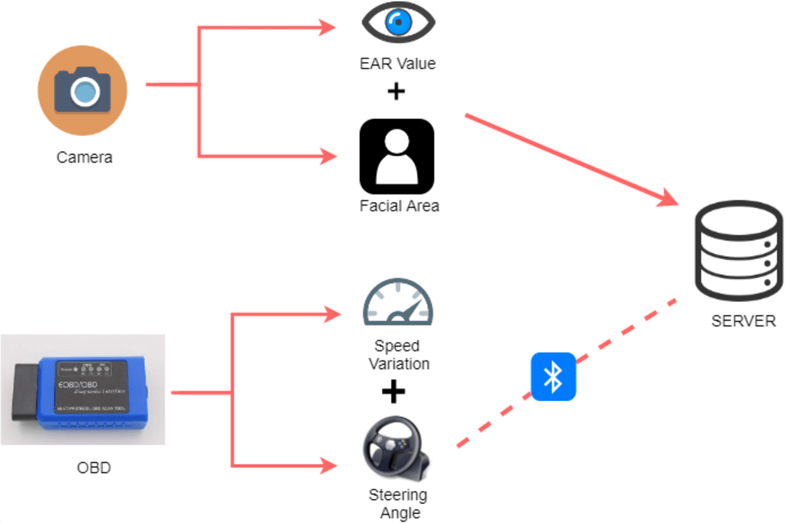
Driver Assistance Application with IoT
How it works
OBD can record the pattern of acceleration and steering angles during the drowsiness of the driver.
Compare the recorded values with the threshold value and the historical data for the actual deviation.
All the calculated data is sent to the data analytics and obtained result, is used to alert the driver.
The cloud data also useful for the vehicle owner.

Slide 41
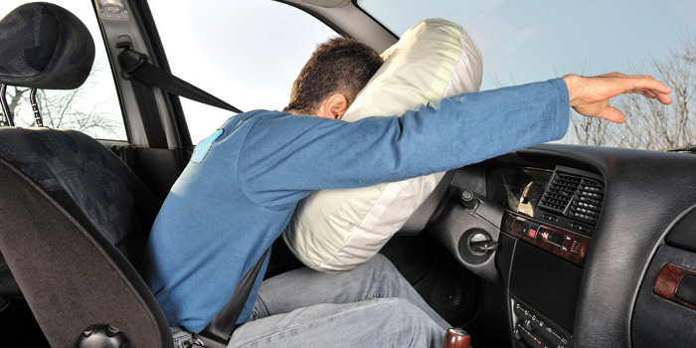
Collision Impact Detection Using IoT
Overview
Modern vehicles are equipped with the collision detection mechanism.
It blow up airbags when an accident occurs and save lives in major cases.
But if the collision is massive then the airbags may not sufficient.
In these cases emergency help needed to save the lives.
So we need a system that measure the severity impact of the collision and send alert messages.

Slide 42
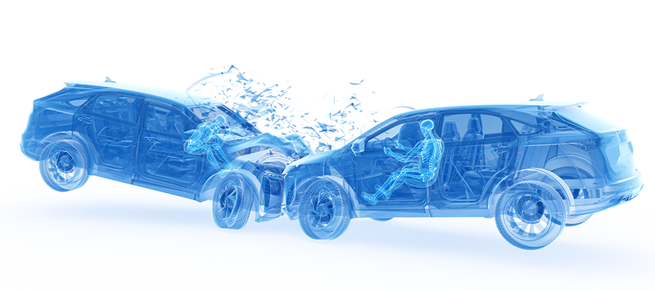
Collision Impact Detection Using IoT
Overview
The messages contents
Location of the accident
Severity impact,
Fire status,
Speed of the vehicle,
Number of passengers,
Time of the incident, etc.
Broadcast the messages to all the authorities like
Ambulance service,
Hospitals,
Highway patrolling team,
Fire brigade,
Police,
Family member of the vehicle owner, etc.

Slide 43
Collision Impact Detection Using IoT
Importance
If a single accident occur in along highway then it can be managed without the data of severity of the collision.
When multiple accident occurs on the highway then the severity data is very important to save lives of the very serious victims.
Based on the data and severity impact, all the emergency help will be reached timely at the point.
Thus, we need an IoT based system that sense the necessary parameters of the collision.

Slide 44
Collision Impact Detection Using IoT
Requirements for IoT Setup
Sensors
FSR Sensor
Fire Sensor
GPS Sensor
Cameras
OBD Access
Controlling
Raspberry Pi
For Monitoring and Analysis
PC
Mobile
Tablet
WAN Connectivity
Cloud Services

Slide 45
Collision Impact Detection Using IoT
Architecture
For Location
Ambulance
Hospitals
Highway Patrolling
Fire Brigade
Police
For Passenger Counting
GPS
Node
Emergency Help
Service Provider
Camera Units
Camera
Passenger Count
USB
Wired / Bluetooth
Central and Remote
Storage/Analysis
Internet
Severity Impact
FSR
Sensor Nodes
Wired / Bluetooth
Vehicle Computer
Cloud Services
Internet
Data Analytics
Internet Gateway
For Detecting Fire
Within Vehicle for Local Analysis and Processing
Research / Decision Making
Internet
Fire
Sensor
Node
OBD
Speed
On Board Diagnostics Unit
Vehicle Owner
Family
Bluetooth
For Speed
Wired / Bluetooth

Slide 46
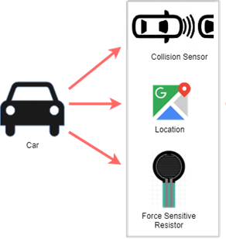
Collision Impact Detection Using IoT
How it works
Force sensitive resistor (FSR) sensors are useful to measure pressure applied on the vehicle during the collision.
The FSR sensor are mounted on the vehicle at the places where impact probability is higher than the other part of vehicle during an accident.
Based on the FSR data we can estimate the severity of the collision.
Fire sensor and GPS should be placed at appropriate place of the vehicle.
All the sensor nodes should have Wired / Bluetooth connectivity with the vehicle computer.
Camera units should be placed on board for capturing all the passengers.

Slide 47
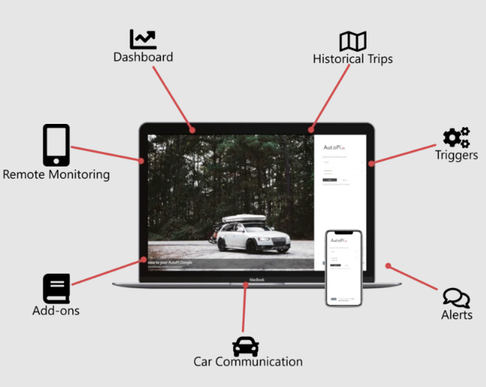
Collision Impact Detection Using IoT
How it works
The camera units should have USB connectivity with vehicle computer.
The camera units sends the captured images to the vehicle computer.
The OBD unit of the vehicle should have Bluetooth connectivity with the vehicle computer
The vehicle computer
Collects the data from the camera units, OBD unit and the sensor nodes.
Apply some business logic,
Do analysis on the collected data on it as per the requirements.
Send the analyzed data to the cloud computer.
Should have Internet connectivity

Slide 48
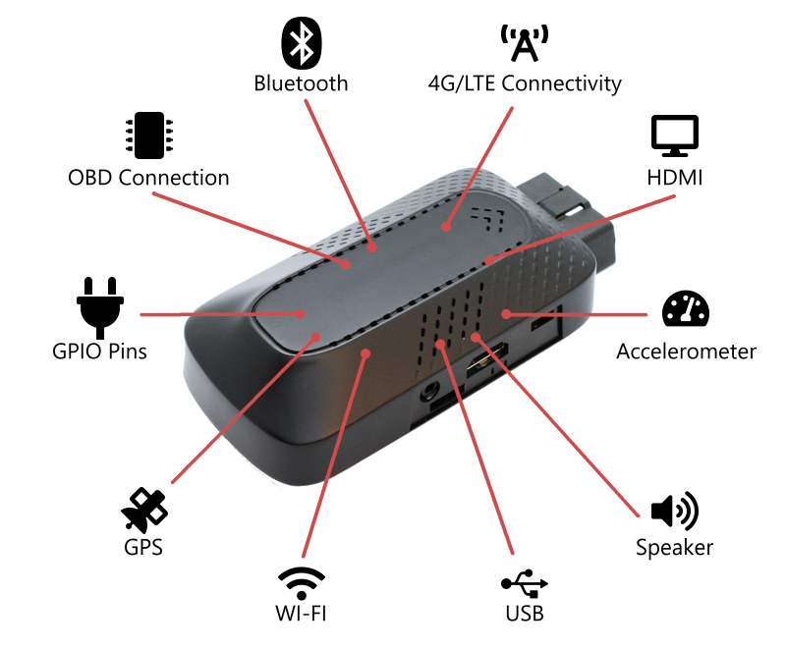
Collision Impact Detection Using IoT
How it works
Using OBD (On-Board Diagnostics) device the system records speeds of the vehicle.
The fire sensor and GPS also sends the sensed data to the vehicle computer.
Based on the analyzed data and severity of the collision the cloud system sent alert messages to all the emergency help service provider and family member of the vehicle owner.
The cloud data is used for data analytics and to provide the priority based emergency services.
The system is automatic activated when the collision is detected.

Slide 49
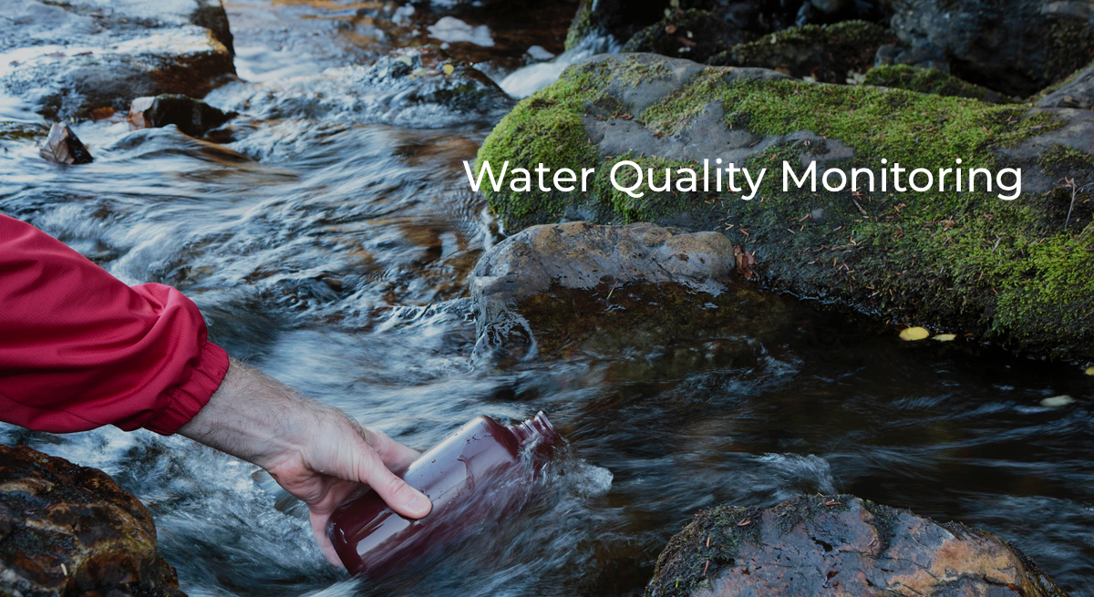
Water Quality Monitoring - IoT Based Application
Overview
Water is essential for life and the polluted water is a one of the major challenge in the world.
So water quality monitoring is necessary for us.
Water Quality Monitoring (WQM) helps in preventing and controlling water pollutions.
Water quality should be checked regularly to avoid serious health issues.
IoT can help to develop a perfect WQM system.

Slide 50
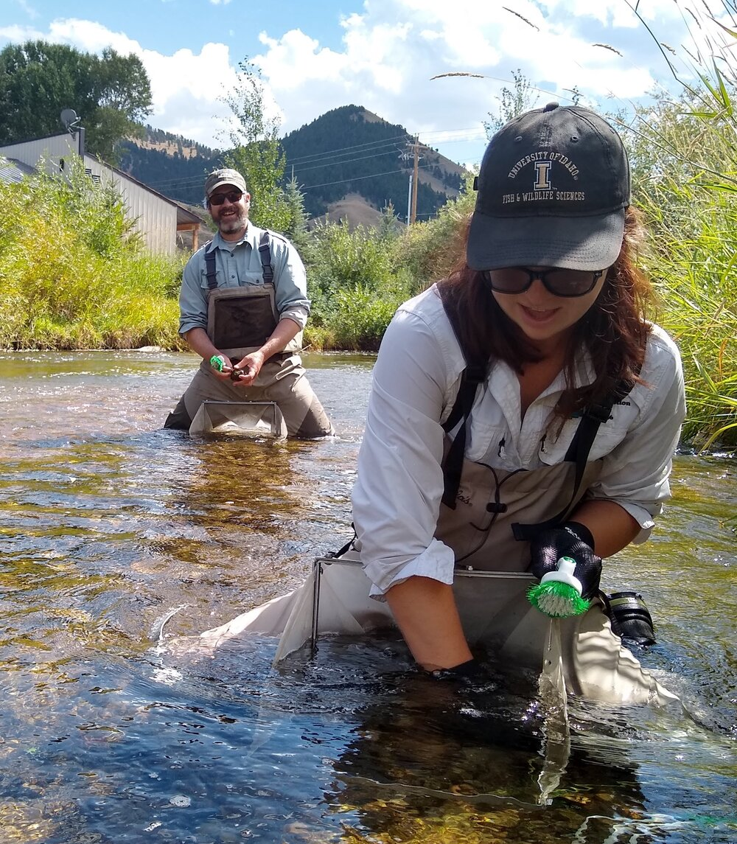
Water Quality Monitoring - IoT Based Application
Importance
At present water quality is monitored very expensive and inefficient by manual or nodal network methods.
Manual Method
Water samples are taken manually from the different points of a water area.
The samples sent to laboratories
Various tests are conducted to find the values of
PH, Conductivity and Temperature
TDS, Dissolved Oxygen
Turbidity
Chloride Content
The reports of the test sends to the concern authorities with in a week.

Slide 51
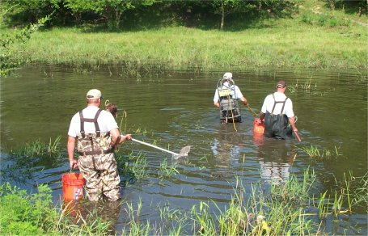
Water Quality Monitoring - IoT Based Application
Importance
Manual Method
The methods have some limitations like
Chance of human error in the sampling
Sampling cost is very high because of to cover very large area of waterbody
Sampling and Testing both are time consuming
Not real-time monitoring which leads to may serious issues.

Slide 52
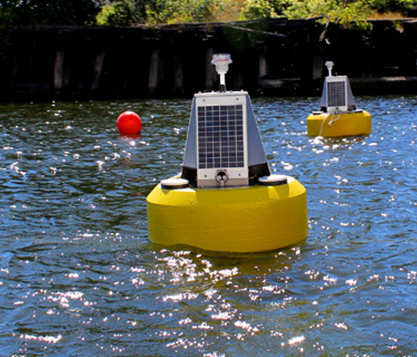
Water Quality Monitoring - IoT Based Application
Importance
Nodal Network Method (Electronics Sensor Monitoring)
Water quality is measured by electronic sensors installed in the different points of a water area.
All the sensors are wirelessly connected with the Internet.
The water quality data sends to the cloud server at regular interval.
This method is giving real-time data contras to the manual method.
System architecture of the monitoring system is divided into following four areas
Sensing
Data Collection
Processing
Communication

Slide 53
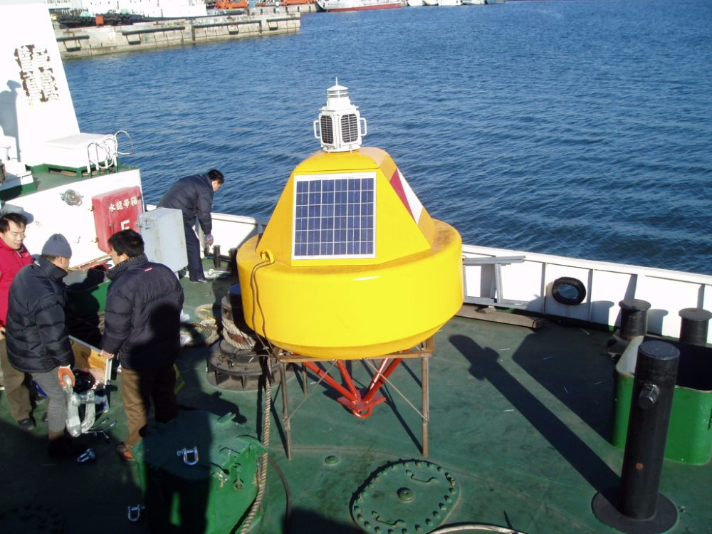
Water Quality Monitoring - IoT Based Application
Importance
Nodal Network Method (Electronics Sensor Monitoring)
The methods have following limitations
Very expansive
Maintenance of the sensors along with power source are challenging
Natural disaster and aquatic animal movement in the waterbody may damage the sensors
The sensors are not moveable

Slide 54
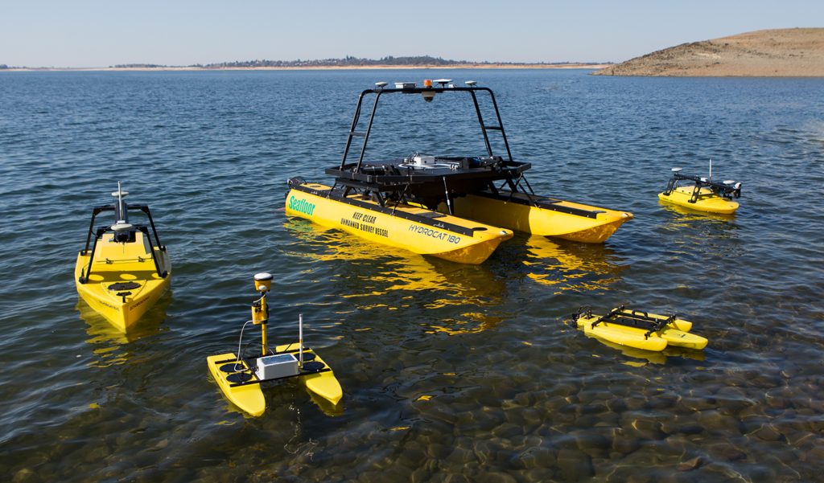
Water Quality Monitoring - IoT Based Application
Importance
A low cost solution is possible for WQM using latest technology, Data Analytics, USVs, Machine Learning, AI and IoT.
No need to install sensors permanently into the waterbody in the solution
An autonomous boat (USV), mounted with all the necessary sensors can
Collect the water quality data and
Send the data to the cloud for data analytics
All the necessary parameters of water can be tracked and measured.
Detailed report of the containment status of the entire waterbody can be generated.

Slide 55
Water Quality Monitoring - IoT Based Application
Requirements for IoT Setup
Water Sensors Kit
For Monitoring and Analysis
PC
Mobile
Tablet
PH Sensor
GPS Sensor
Turbidity Sensor
TDS and Dissolved Oxygen Sensor
Temperature Sensor
Conductivity Sensor
Controller
ESP32 MCU or
Arduino Uno with Wi-Fi or Network Shield
WAN Connectivity
GPRS or GSM Module
Cloud Services
Unmanned Surface Vehicle (USV)

Slide 56
Water Quality Monitoring - IoT Based Application
Architecture
Report Generation
Water Quality Sensors Kit
Pollution Control Board
Temperature Sensor
PH
Sensor
Central and Remote
Storage/Analysis
Internet
GPS Sensor
Sensors Kit Controller
Node
Wired
GPRS / GSM Module
Internet
Cloud Services
Internet
Data Analytics
Turbidity Sensor
Unmanned Surface Vehicle
Research / Decision Making
Internet
TDS and DO Sensor
Conductivity Sensor
USV Controller Node
USV
Control Panel
Base Station,
USV Operator
Wired

Slide 57
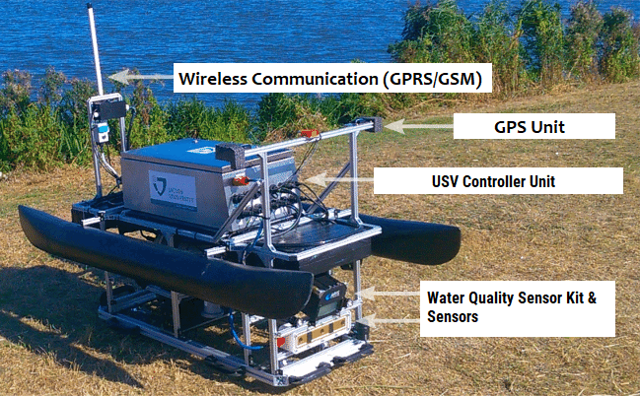
Water Quality Monitoring - IoT Based Application
How it works
A bundle of all the sensors or a water quality sensor kit should be mounted on an autonomous or unmanned surface vehicle (USV).
The USV can be operated by an embedded controller node.
The USV should have GSM or GPRS internet connectivity with the cloud server.
The sensor kit sense the following values
PH Value of Water - PH Sensor
Temperature of Water - Temperature Sensor
Conductivity of Water - Conductivity Sensor
Clarity of Water - Turbidity Sensor
Dissolved Solid and Oxygen in Water– TDS and DO Sensor
Location of the reading - GPS Sensor

Slide 58
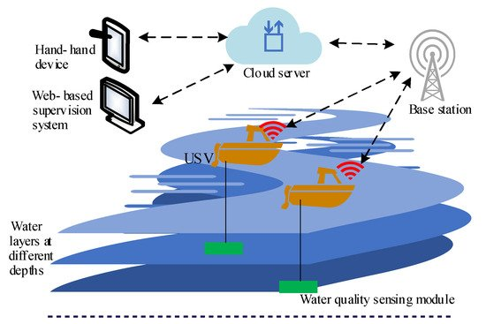
Water Quality Monitoring - IoT Based Application
How it works
The kit controller node sends all the sensed data to the cloud server via GPRS/GSM module
The GPRS/GSM module is used to provide the Internet connectivity with the cloud server.
The cloud
stores all the data received from the USVs,
Execute some business logic and
Do analysis on the stored data.
All those who have rights to access the cloud data can get water quality records of the waterbody.
Like,
Members of Pollution Control Board
Data analytics team
USV operator

Slide 59
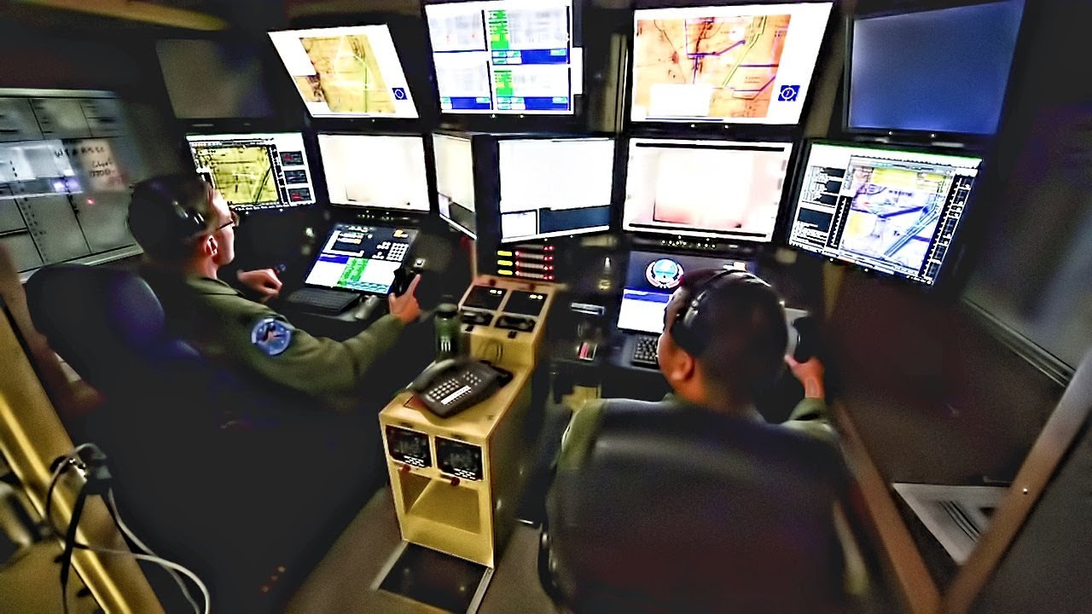
Water Quality Monitoring - IoT Based Application
How it works
Authorities of the board and data analytics teams may execute corrective action based on the data.
An USV control panel is installed in the base station of the WQM system.
The control panel should have internet connectivity for controlling the USV.
Using the control panel, an operator can set paths and control the USV.

Slide 60
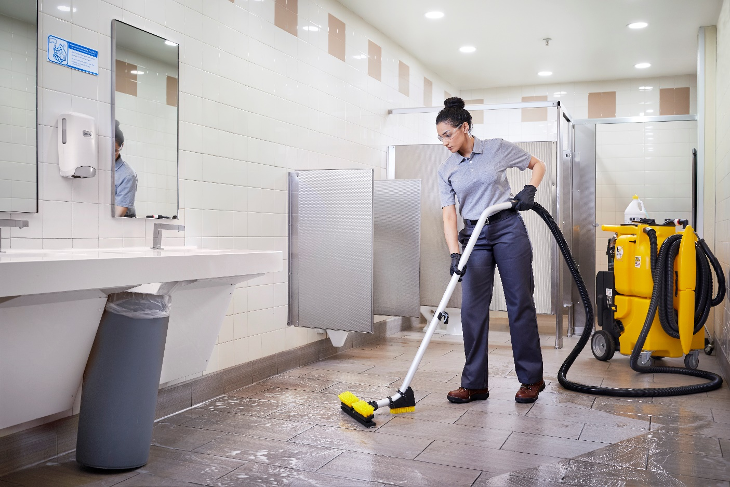
Smart Lavatory - IoT Based Application
Overview
In the all businesses retaining old customer is more meaningful then the finding new.
It is possible by
Offering good quality products,
Best services and
The pleasant experience while visiting your place.
Hygiene and comfort in lavatory is one of the major concern of the businesses.
Maintaining and monitoring cleanliness in lavatory is a challenging task.

Slide 61

Smart Lavatory - IoT Based Application
Importance
Mostly lavatory cleaning and monitoring is manually done by cleaning staff.
Because of the manual process some time it’s not done properly.
Unclean lavatory may become a root cause of many diseases.
User may suffer because of unavailability of water or toilet papers in many cases.
Slippery and wet floor might be unsafe for users.
An IoT based smart lavatory monitoring system is needed to solve the above mentioned issues.

Slide 62
Smart Lavatory - IoT Based Application
Requirements for IoT Setup
Water Sensors Kit
For Monitoring and Analysis
PC
Mobile
Tablet
MQ05 Gas Sensor
Touch Sensor
Sharp IR Sensor
Water Level Float Sensor
Controller
ESP32 MCU or
Arduino Uno with Wi-Fi or Network Shield
LAN and WAN Connectivity
Router and Switches
Wireless Access Point
Cloud Services

Slide 63
Smart Lavatory - IoT Based Application
Architecture
For Feedback
Touch Sensor Nodes
Cleaning & Monitoring Team
Sweepers and
Supervisor
Wi-Fi
Monitoring System
Store Manager,
Support Agency and Other Staff
Wi-Fi / LAN
Central
Storage/Analysis
For
Hygiene
Gas
Sensor Nodes
Internet
Controller Nodes
Wi-Fi LAN
Local Server
Cloud Services
Internet
Data Analytics
Internet Gateway
Wi-Fi
Water Level Float Sensor Nodes
Internet
For
Flush Tank
Within Organization for Local Analysis and Processing
Research / Decision Making
Customers
Sharp IR
Sensor Nodes
Wi-Fi
For Toilet Paper Dispenser

Slide 64

Smart Lavatory - IoT Based Application
How it works
All the sensor nodes should be placed at various places in the lavatory area.
The sensor nodes should have Wi-Fi connectivity with controller nodes.
The sensor nodes sends the sensed data to the controller nodes.
The controller nodes
Collects the data from all the sensors,
Apply some business logic on it as per requirements and
Send it to local computer.
All the controller nodes should have connected with the Local Area Network.

Slide 65

Smart Lavatory - IoT Based Application
How it works
Gas sensors are used for monitoring various gases levels like ammonia and methane level in the lavatory.
Touch sensors are used for customers’ feedback about ambiance and cleanness in the lavatory.
Water level float sensors are used for monitoring water level in the flush tank and the flush count.
Sharp IR sensors are placed in the toilet paper dispenser for monitoring remaining toilet papers.

Slide 66

Smart Lavatory - IoT Based Application
How it works
Local server
Receives all the data from all the controller nodes,
Execute some business logic and
Do analysis on the collected data, and
Send the essential data to the cloud computer.
All the cleaning & monitoring team members can be accessed following from the local server .
Status of lavatory cleanness,
Water and toilet paper availability
The local server should have Internet connectivity to communicate with the cloud.

Slide 67

Smart Lavatory - IoT Based Application
How it works
The cloud
stores all the data received from the local server,
execute some business logic and
do analysis on the stored data.
All those who have rights to access the cloud data can get desire information and alerts, like
Store manager
Service support agency
Local staff members
Data analytics team
Customers
The store manager and data analytics teams may execute corrective action based on the analyzed data.

